Slide 1
Name: Saikat Talukdar
Hackathon Challenge for Data Science - Problem Statement - UpGrad | May'24

Slide 2

Ecommerce Product Categorization

Slide 3
The problem
Build and train a multi-class text classifier model using the dataset provided.
20XX | 20XX | 20XX | 20XX

Slide 4

Steps performed
1. Analyse the dataset
2. Visualize and preprocess the data
3. Feature Engineering using Count Vectorization/TF-IDF
4. Building Machine Learning and deep learning models
5. Hyperparameter tuning
6. Model Evaluation

Slide 5
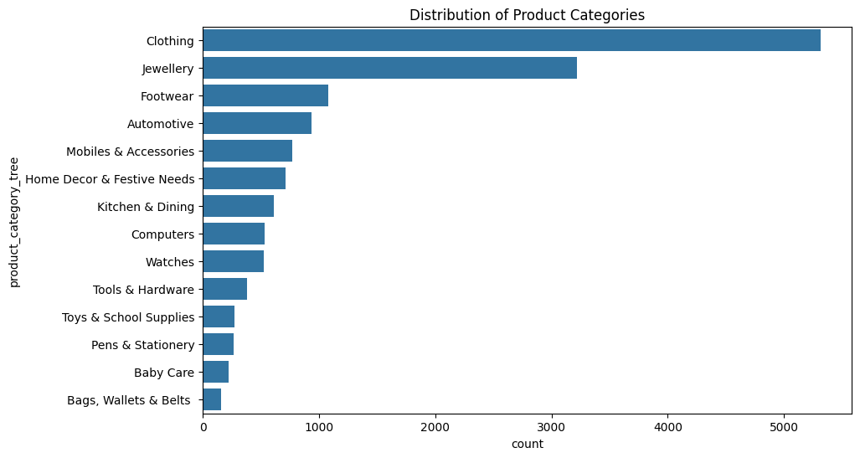
Data Distribution across Categories

Slide 6
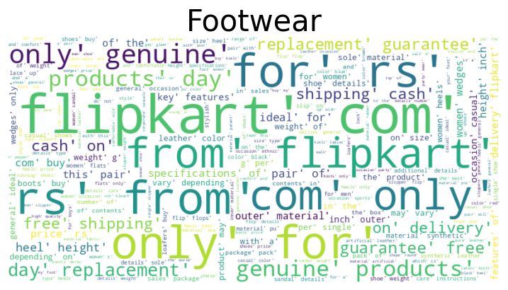
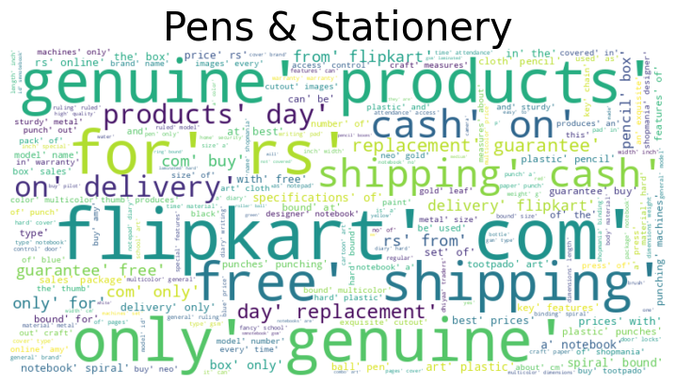
Data Distribution across Categories
As we can see, there are many generic words repeating across categories.

Slide 7
Data Cleaning
Generic irrelevant words like flipkart,price,genuine,only, delivery,free,shipping,guarantee, etc removed from the descriptions.
Stopwords removal done.
Numbers,extra white spaces, non-word characters cleaned from the text descriptions.

Slide 8
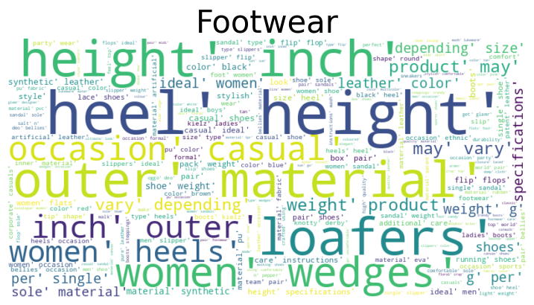
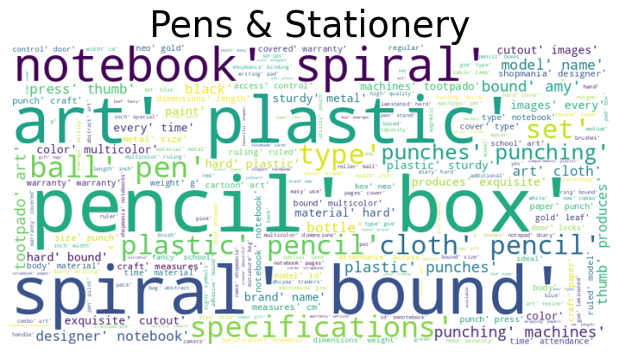
After Data Cleaning
Now we can see, the generic words are not repeating like before. We see the most frequent words relevant to the category.

Slide 9
Feature Engineering
Both Count Vectorization and TF-IDF method applied.
Found model performance better in case of TF-IDF with undersampled train data.
So, TF-IDF used as vectorization method.

Slide 10
Dimensionality Reduction
Since vectorization created 10000 features, dimensionality reduction PCA applied to reduce it to 300.
Truncated SVD method applied as the dataset is very large.

Slide 11
Model Selection
All machine learning classification models like Logistic Regression, Random Forest, SVC,Decision Tree, Gradient Boosting, XGBOOST tried.
Deep learning model with 2 Dense layers of 128 and 64 neurons with 2 Dropout layers.

Slide 12
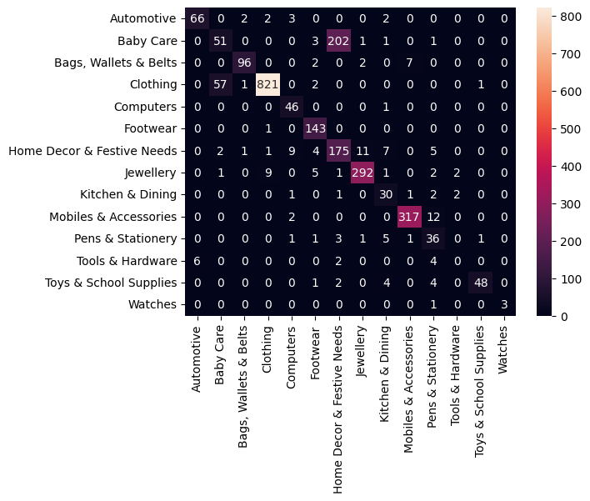
Model Performance
Logistic Regression model confusion matrix.
Weighted average score=83%

Slide 13
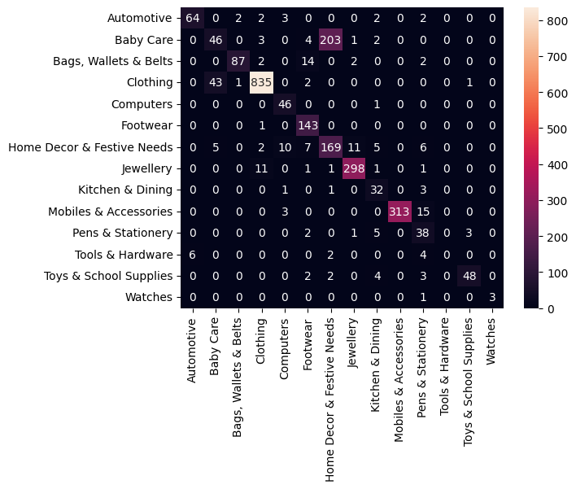
Model Performance
SVC model confusion matrix.
Weighted average score=83%

Slide 14

Model Performance
Deep Learning model confusion matrix.
Weighted average score=84%

Slide 15
Key Insights from the data
In the training data, there was class imbalance in product category column for which undersampling method was used to address it.
Deep Learning model giving an weighted average score of 84% and Logistic Regression and SVC giving a weighted average score of 83% on the test data predictions.

Slide 16
Addressing Misclassifications
Found that there is a lot of misclassification in ‘Baby Care’ category which is mispredicted by all the models as ‘Home Decor & Festive Needs’ possibly due to generic and ambiguous descriptions.

Slide 17
Conclusion
We can deploy the deep learning model

Slide 18
Q n A
Any questions?

Slide 19
Thank you

